Slide 1
Document Object Model

Slide 2

TABLE OF CONTENTS 1. Basic intro – Definition of DOM 2. Selecting Elements 3. Traversing Elements 4. Working with Attributes 5. Manipulating Elements 6. Manipulating style of Elements 7. Working with Events 8. Scripting Web Forms

Slide 3

What is DOM?
Why DOM?

Slide 4
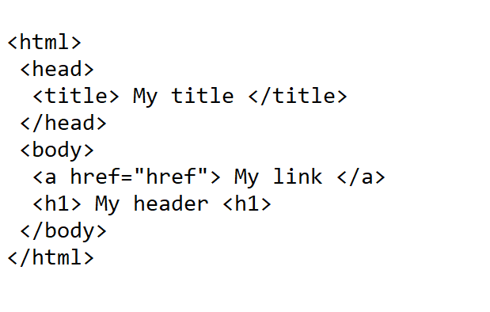

Slide 5

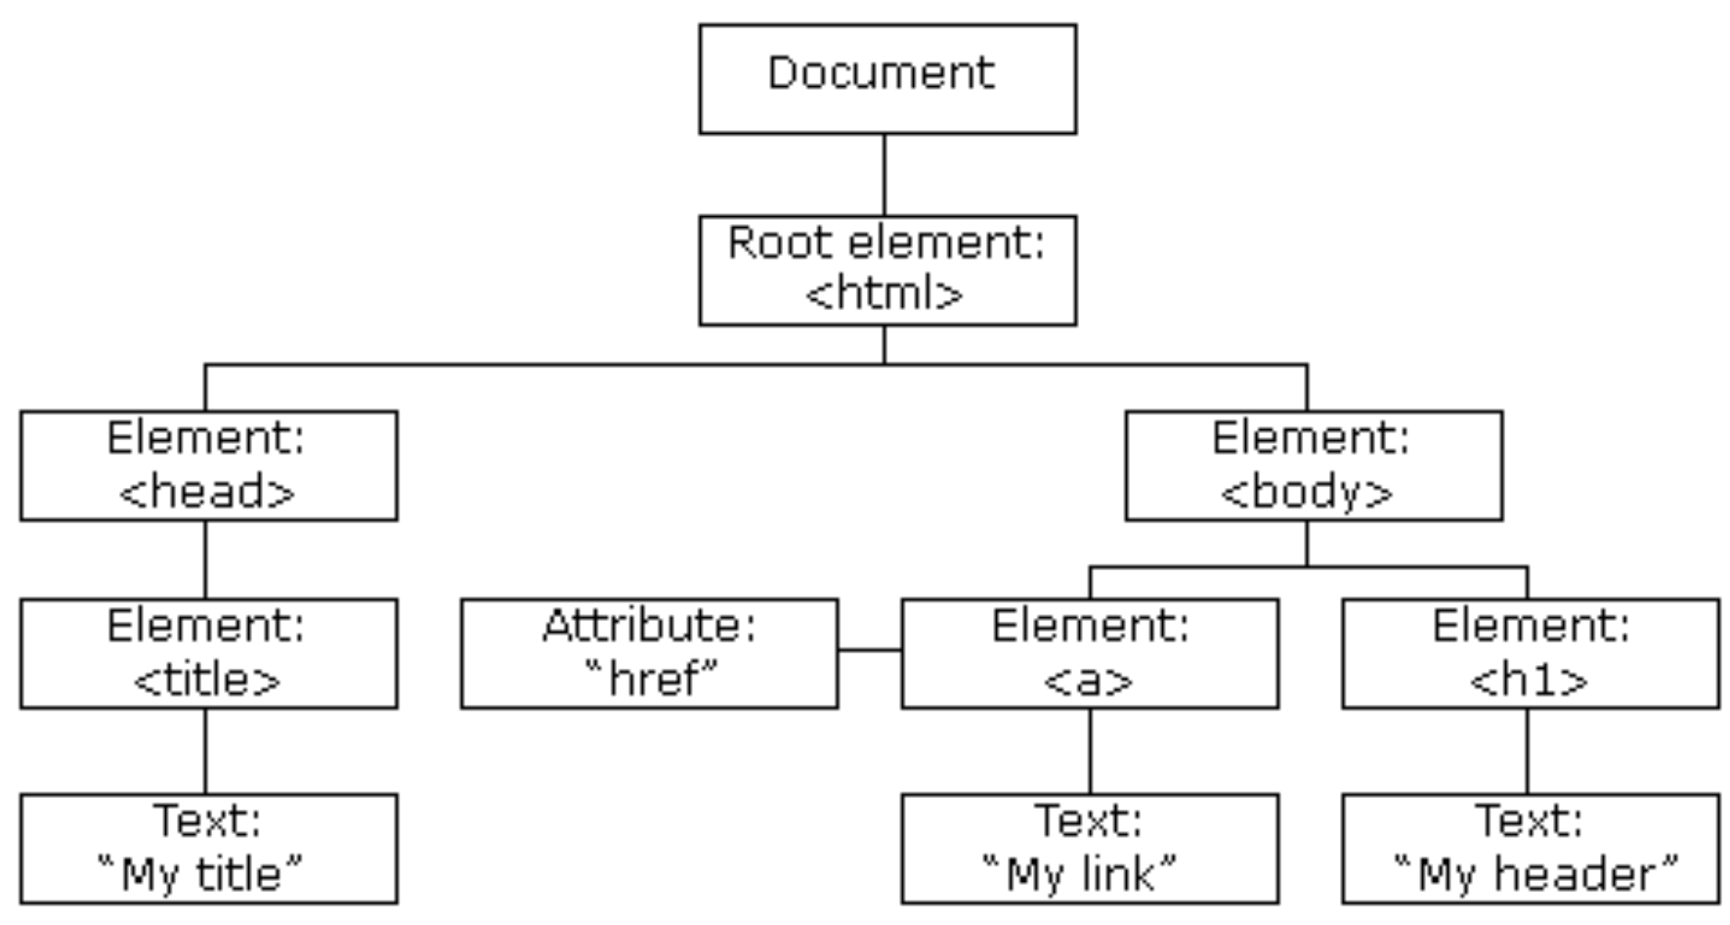

Slide 6
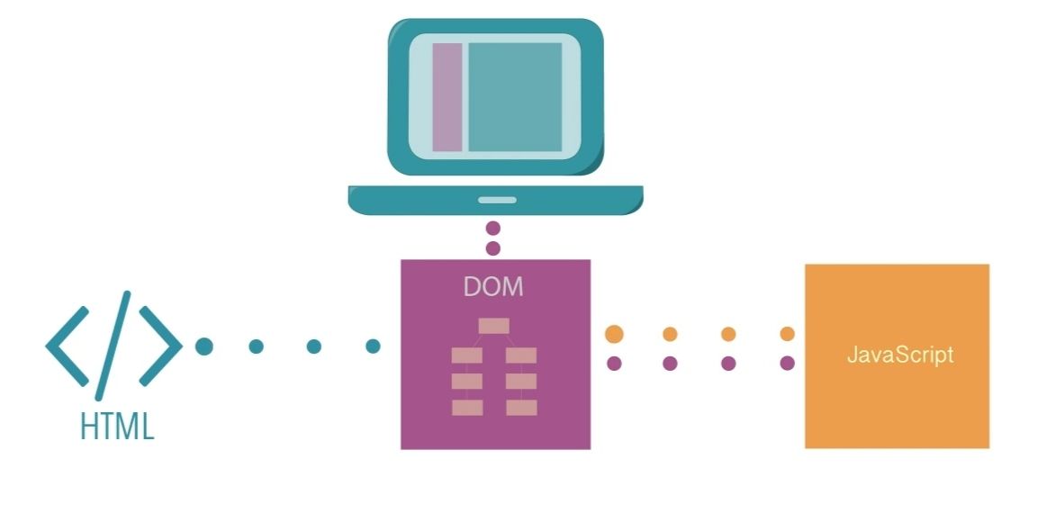

Slide 7

DOCUMENT OBJECT MODEL
File(HTML/XML) Tags/Elements Layout/
of the File Structure

Slide 8

DOM
is an API
that can be used with
any programming languages like JS
to represent the webpage
in a tree structure
so that the programs
can read, access, change a document’s
structure, style or content

Slide 9
Selecting elements in a DOM tree

Slide 10
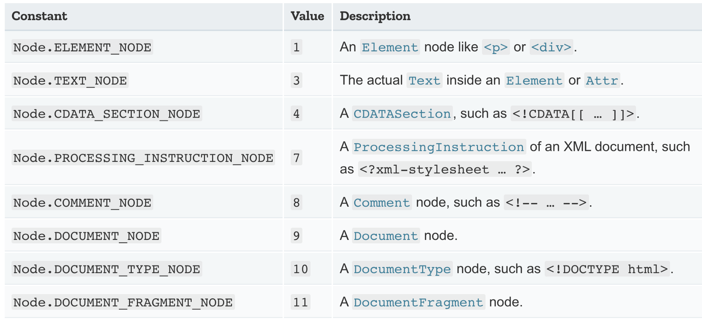
TYPES OF NODES

Slide 11
1. getElementById Method
SYNTAX: document.getElementById(id);
2. getElementsByName Method
SYNTAX: document.getElementsByName(name);
3. getElementsByTagName Method
SYNTAX: document.getElementsByTagName(tagName);
4. querySelector Method
SYNTAX:
element = parentNode.querySelector(selector);
elementList = parentNode.querySelectorAll(selector);

Slide 12
How to traverse the DOM tree?

Slide 13
1. previousSibling
2. nextSibling
3. childNodes
4. firstChild
5. lastChild
6. parentNode

Slide 14
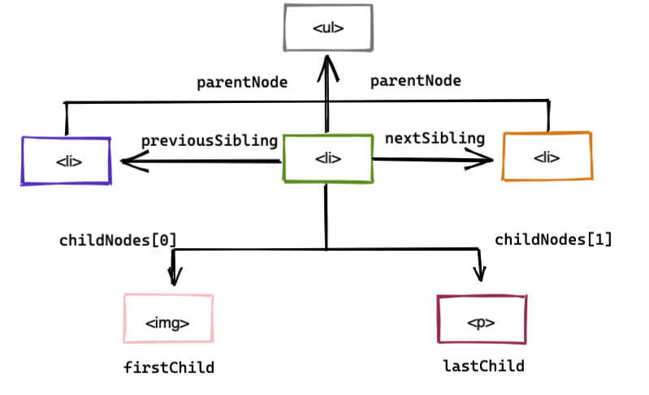

Slide 15
Working with attributes

Slide 16
1. setAttribute method:
SYNTAX: element.setAttribute(name, value);
2. getAttribute method:
SYNTAX: value = element.getAttribute(name);
3. removeAttribute method:
SYNTAX: element.removeAttribute(name);
4. hasAttribute method:
SYNTAX: result = element.hasAttribute(name);

Slide 17
Manipulating elements

Slide 18
1. innerHTML property
2. createElement() method
3. appendChild() method
4. textContent property
5. insertBefore() method
6. cloneNode() method
7. removeChild() method
8. replaceChild() method
9. append() method
10. prepend() method

Slide 19
THANK YOU

